Slide 1

COURSE EE284 PROJECT- 1
A Hands-on SIP-based VoIP Experiments on: Call Establishment, Busy Lines, Call on Hold, and Conference Calling
GROUP- 4
Parvathi Chandrasekhar (012474995)
Varsha Ajay Kohirkar (012031643)
Gaojun Su (012465518)

Slide 2
Overview of Presentation
Project Overview and Objective
Hardware Setup and Tool Downloads
PART – 1
Establish a call between 2 SIP Clients
Busy User
Call on Hold
Call Conferencing
PART – 2
Develop a Client using PJSIP and PJSUA
Register and Unregister
Initiate a call and hangup

Slide 3
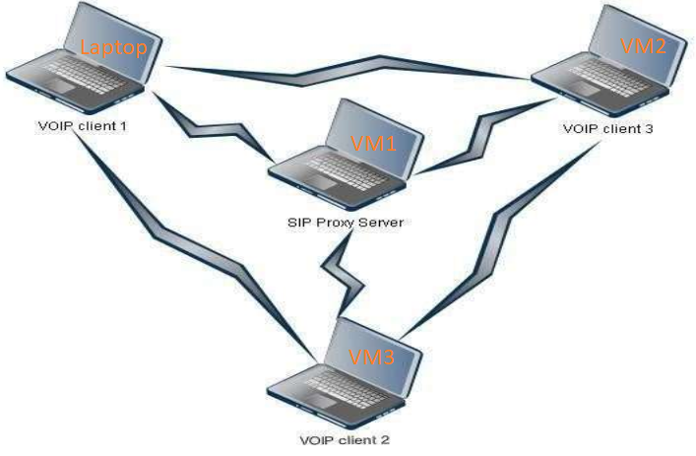
Project Overview and Objective
The aim of the project is to understand the implementation of SIP to enable media transfer or voice communication. The project comprises of one server and three clients to implement the four phases. We have achieved this using the VM approach.
Create a SIP client script using python. The client can successfully register, unregister and send a call invite to another client as well as hang up.
Hardware and Software Setup

Slide 4
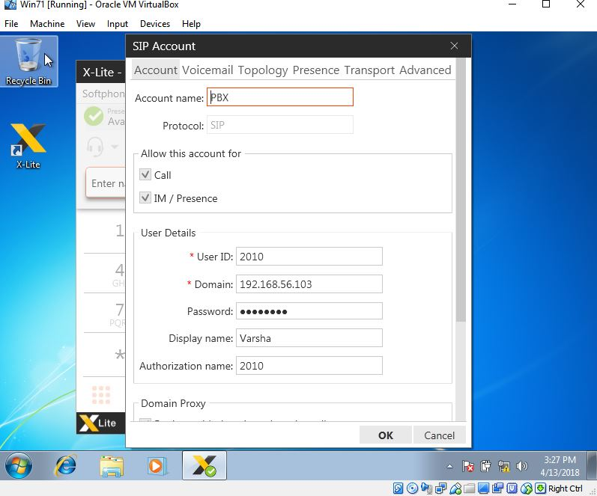
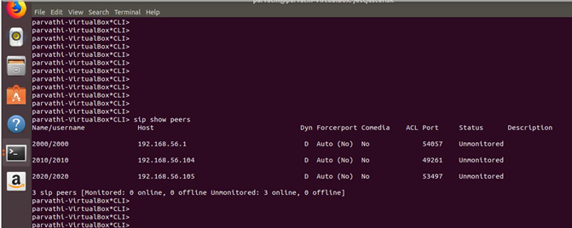
Software tools and configuration
VirtualBox
Ubuntu System and Asterisk as server
Windows 7 system and X-Lite as clients
PJSIP and PJSUA

Slide 5
PART-1 File configuration of sip.conf: (server and one client for example)
[2000]
username=2000
type=friend
secret=password
host=dynamic
context=from-sip
[general]
port = 5060 ; Port to bind to (SIP is 5060)
bindaddr = 192.168.56.103 = Asterisk server IP address
allow = ulaw ; Allow all codecs

Slide 6
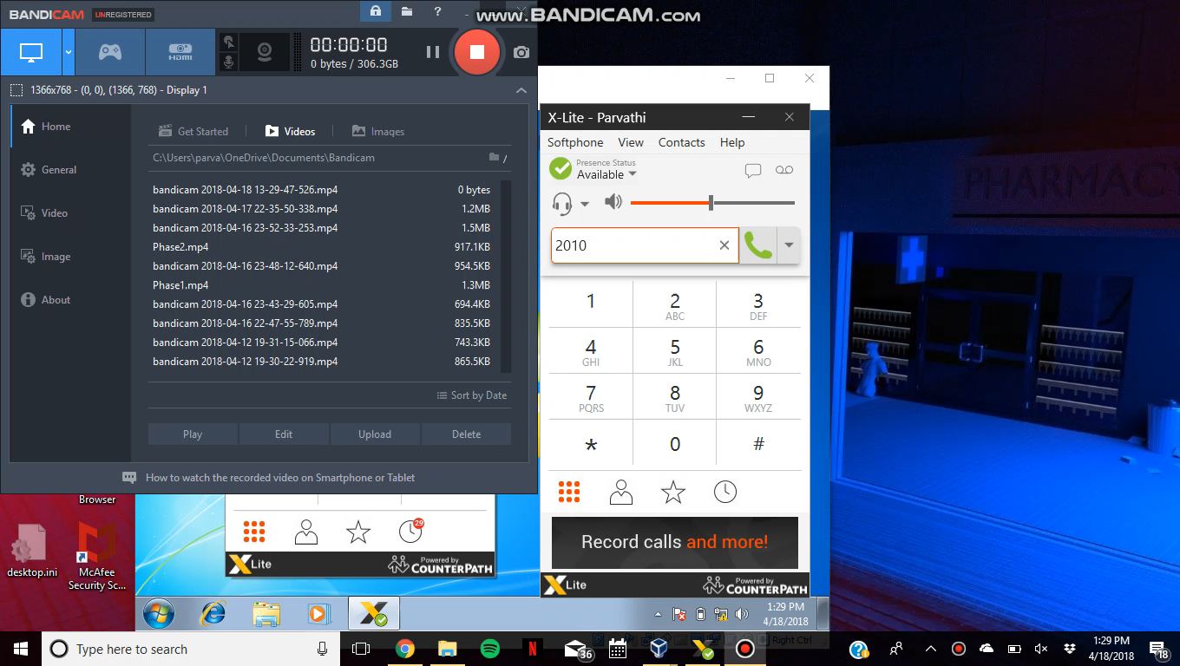
PHASE 1- Establish and Analyze a Successful Call Between 2 SIP Clients:
Modification of extensions.conf
Video show:
[from-sip]
exten => 2000, 1, Dial(SIP/2000,20)
exten => 2000, 2, Hangup
exten => 2010, 1, Dial(SIP/2010,20)
exten => 2010, 2, Hangup

Slide 7
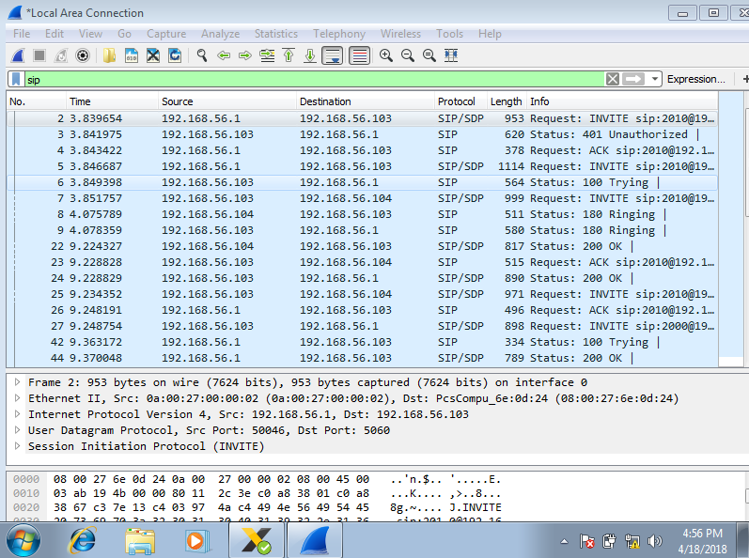
Wireshark capture:
Call accepted

Slide 8
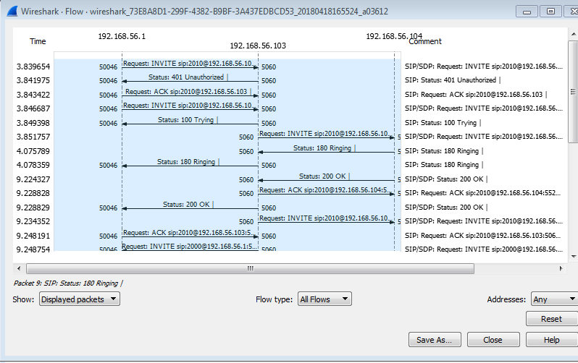
Wireshark capture:
Call Flow between 2000 and 2010 after accepting

Slide 9
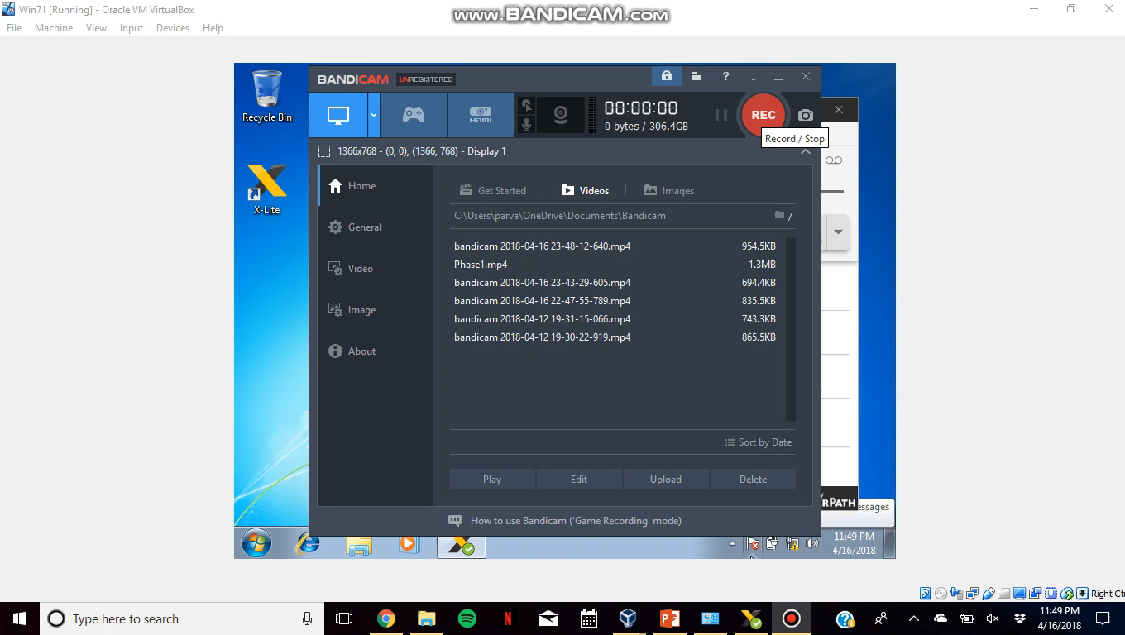
PHASE 2- Busy User:
In this part of the experiment, we make one user (such as 2010) busy while the other user tries to call it through the server, and we want to analyze the SIP messages exchanged. when client 2000 tries to call, a busy condition is experienced. The time duration for which the user
Modification of extensions.conf
[from-sip]
exten => 2000,1,Dial(SIP/2000,20)
exten => 2000,2,Hangup
exten => 2010,1,Answer()
exten => 2010,2,Busy(10) ;10sec
exten => 2010,3,Hangup

Slide 10
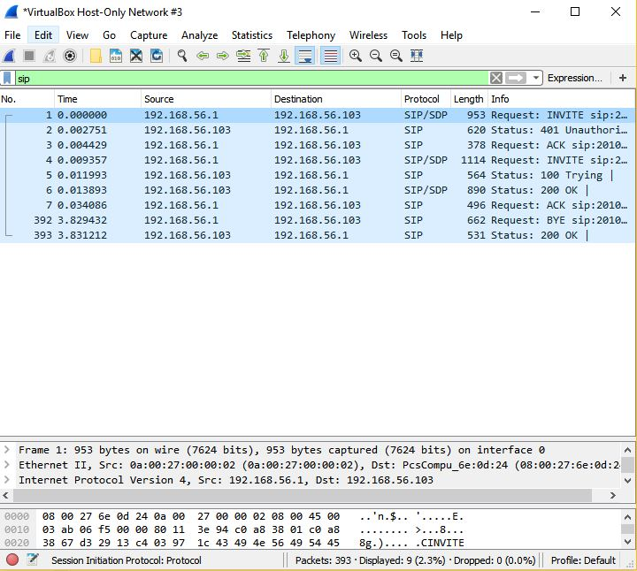
Wireshark capture:
SIP messages exchanged between the clients

Slide 11
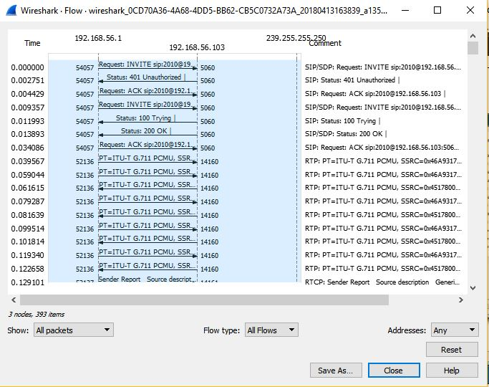
Wireshark capture:
Packets Flow between clients

Slide 12
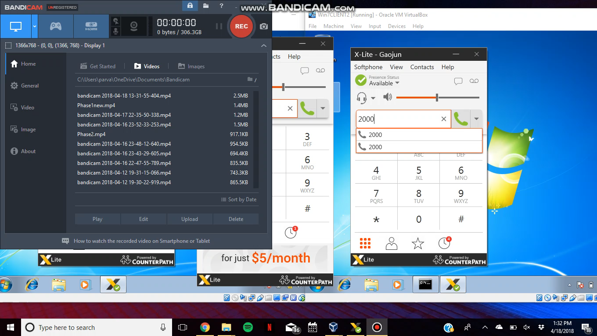
PHASE 3 - Call on Hold:
In this scenario, user ID 2020 will try to call ID 2000, but the conversation between user ID 2000 and 2010 is already established. When user ID 2020 tries to call user ID 2000, user 2010 will be kept on hold and accepts the call from user ID 2020. And after completing the call with user ID 2020, the call with user ID 2010 resumes
sip.conf
[2020] username=2020 type=friend secret=password host=dynamic context=from-sip
extensions.conf
exten =>2020, 1, Dial(SIP/2020,20) exten => 2020, 2, Hangup

Slide 13
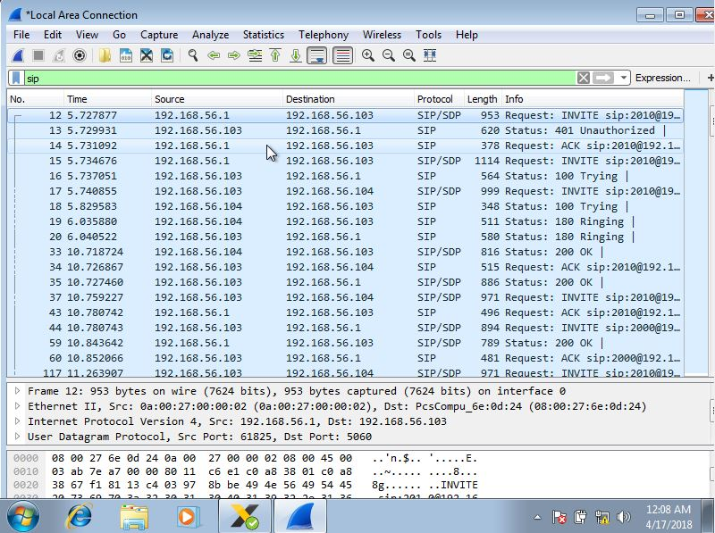
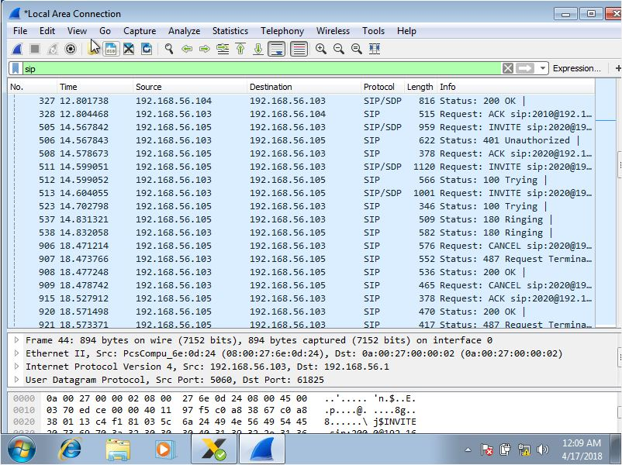
Wireshark capture:
Calling between clients

Slide 14
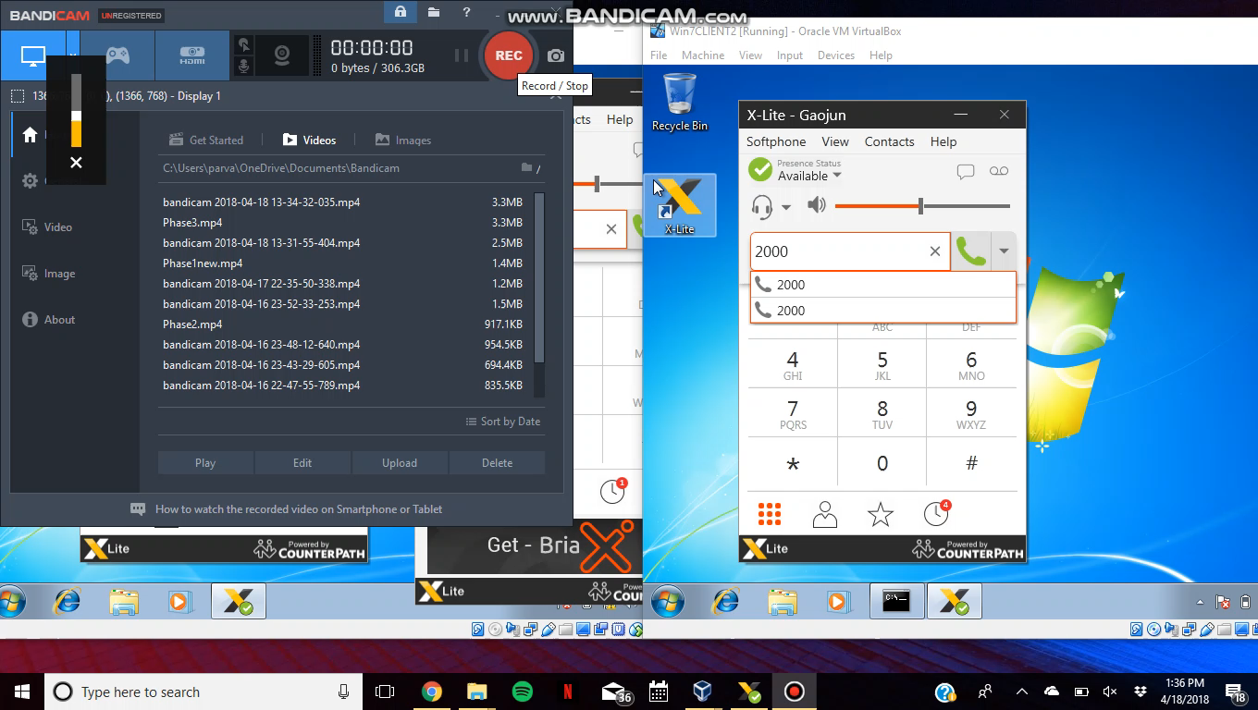
PHASE 4 - Call Conferencing:
Use the same file configuration in phase 3. In this scenario, user 2020 tries to call user 2000, when the call between user 2000 and user 2010 is already established. When user 2020 tries to call user 2000, user 2000 keeps user 2010 on hold and accepts the call from user 2020. Then, the calls are merged to form a conference call.

Slide 15
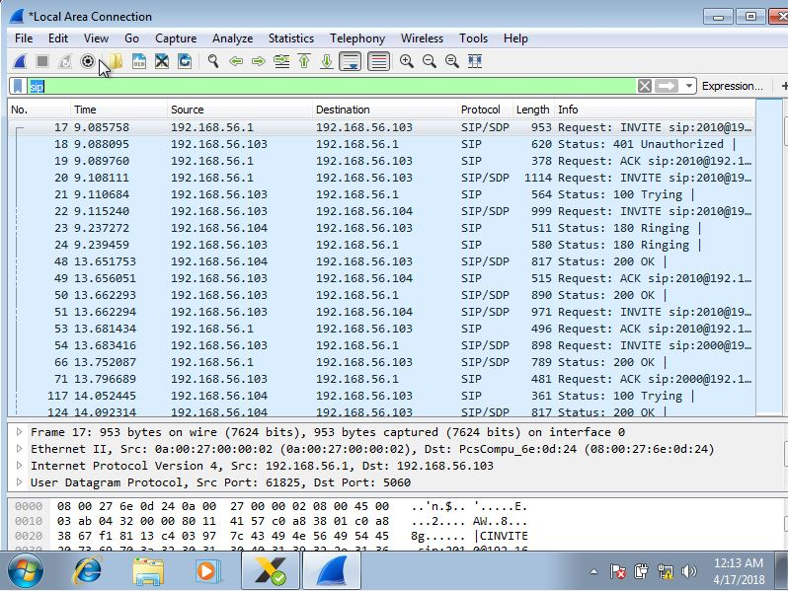
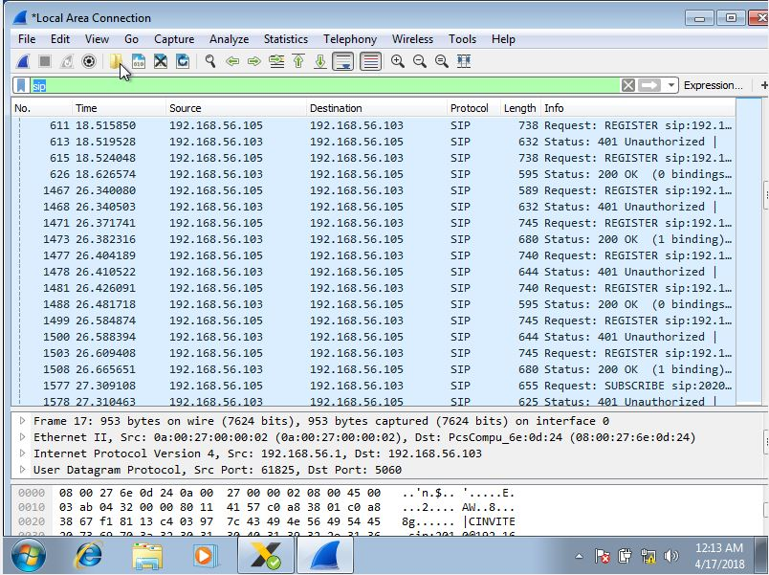
Wireshark capture:
Call Established between clients

Slide 16
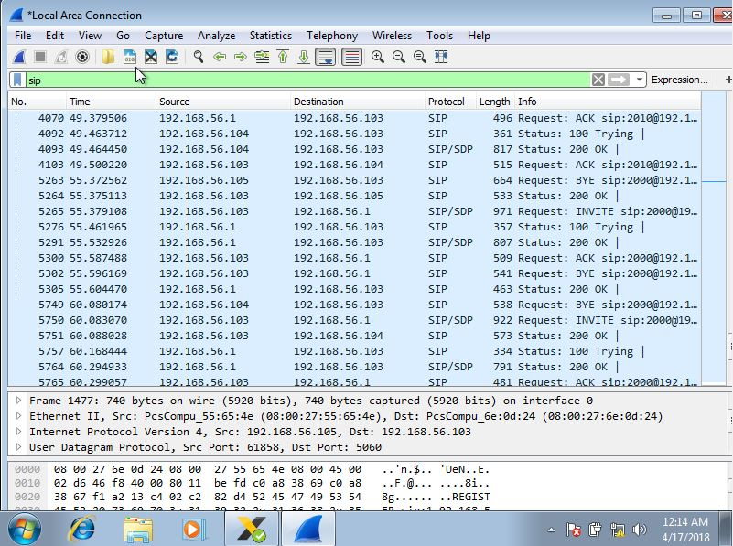
Wireshark capture:
Call Established between clients

Slide 17
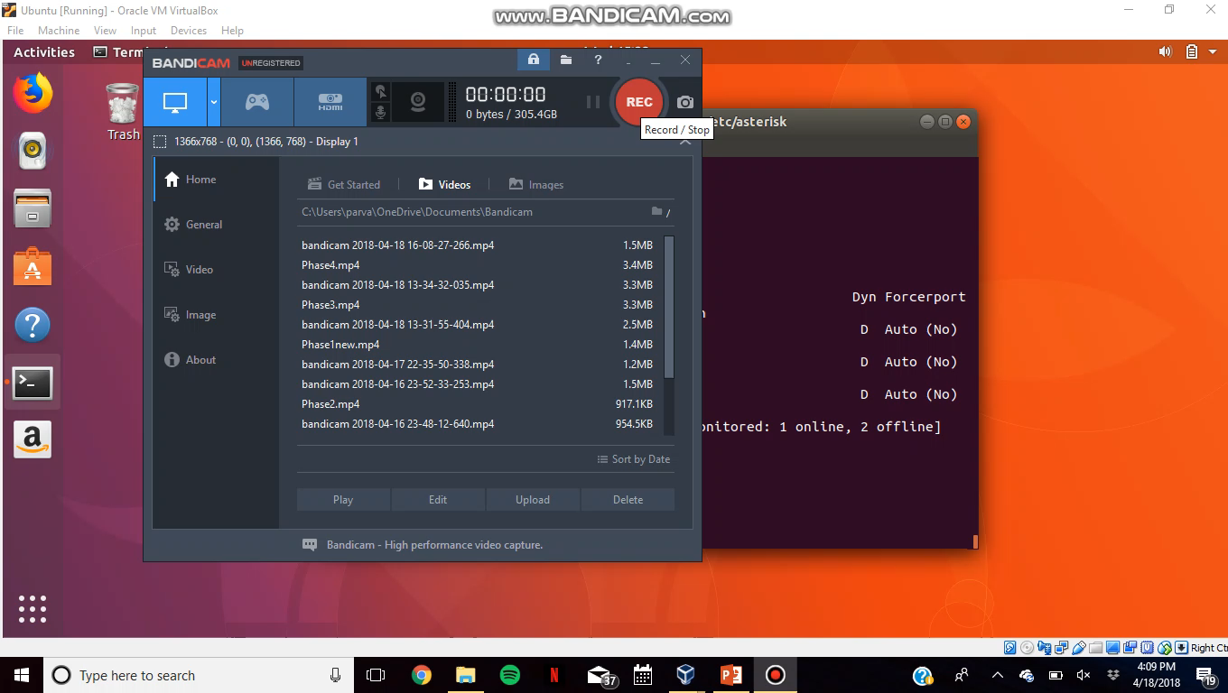
PART-2
Registering Client:
Calling
Hanging up
Unregistering Client

Slide 18
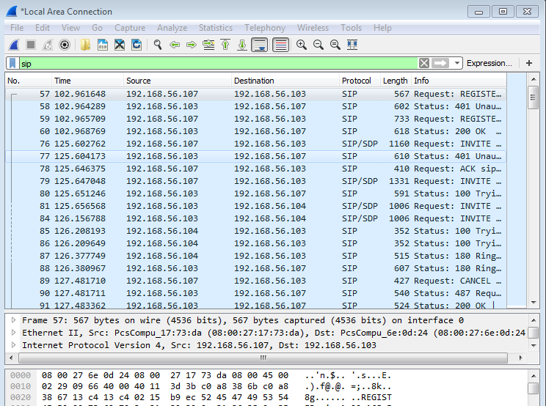
Wireshark captures: Registration

Slide 19
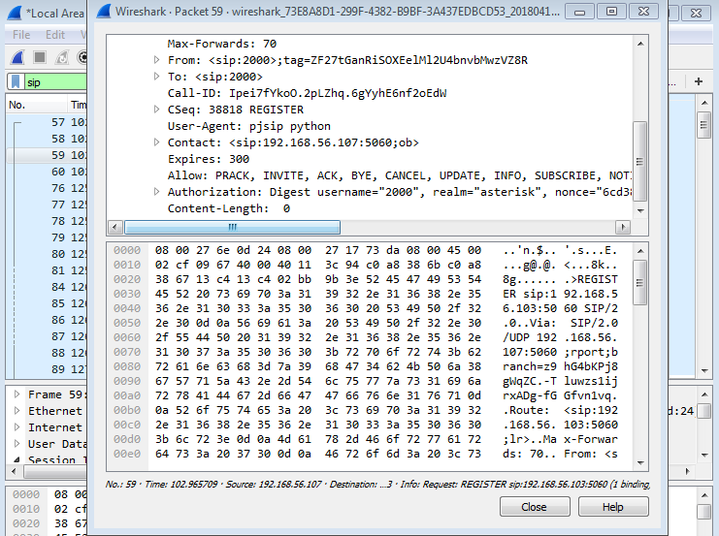
Registration Lifetime:

Slide 20
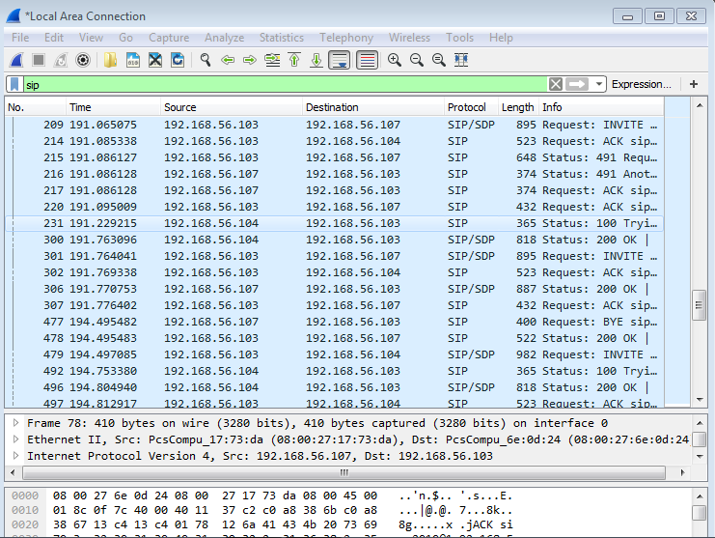
Hanging up from client script

Slide 21
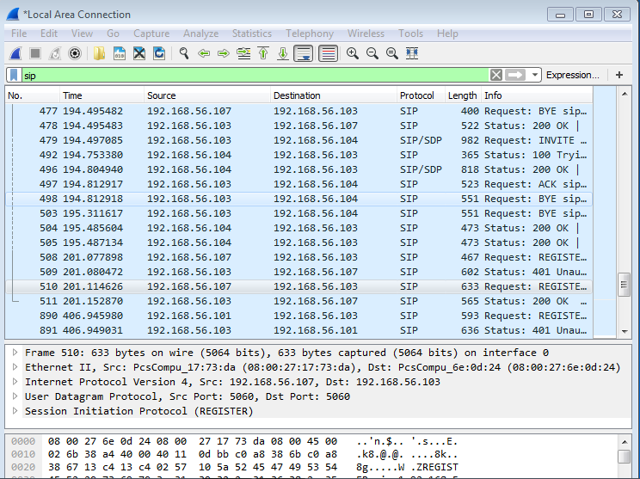
Unregistration

Slide 22
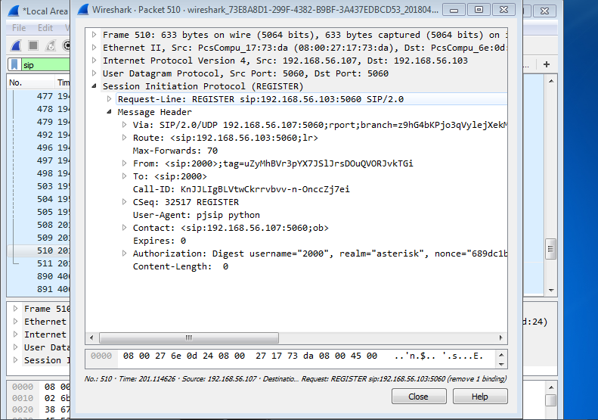
Unregistration expiry

Slide 23
Project Summary:
In the project we gained practical experience for configuration of the server and clients using Asterisk software and X-Lite softphones. We also observed the signaling messages in SIP.
We implemented four different call scenarios while observing the SIP messages. We implemented SIP client using a python script, with basic features such as calling, hanging up from script and unregistration from server.

Slide 24
THANK YOU

